Slide 1
Analysis of Algorithms
Final Project
Authors: Instructor: Dr. Valentina Korzhova
Maria Martinez
Miguelangel Rodriguez
Olivia Huegel

Slide 2
Algorithms
BFS
DFS
Dijkstra’s Algorithm
Used to solve an 8-puzzle

Slide 3
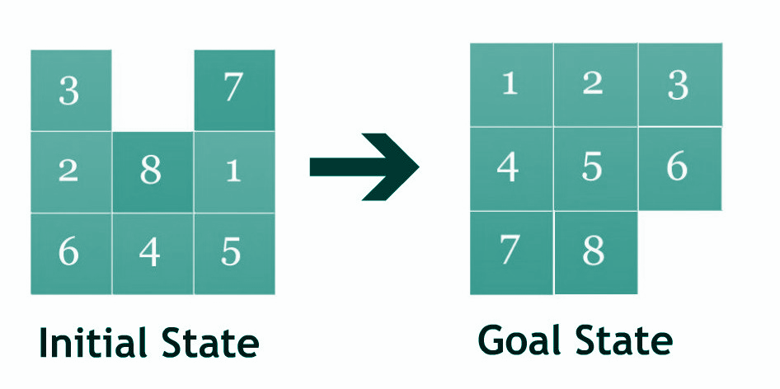
Task Description
The task we were given is to find a cheapest solution to an 8-puzzle
The initial state of the 8-puzzle is randomized
and not solved in order.
The goal state of 8-puzzle is how the puzzle
looks once the algorithm has completed and the puzzle
is solved.
We used BFS, DFS, and Dijkstra algorithms to solve
the 8-puzzle.

Slide 4
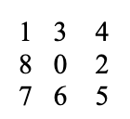
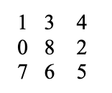
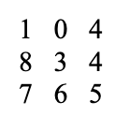
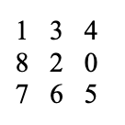
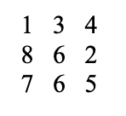
BFS and DFS Algorithms Cost
Example
*For BFS and DFS algorithms, the cost of moving a tile is 1. The ordering of a move is: left, up, right, down

Slide 5
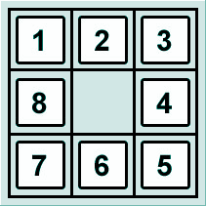
Dijkstra’s Algorithm Cost
Example
The cost of moving tile 1 is $1 plus the number of displaced tiles of 1.
The cost of moving tile 2 is $2 plus the number of displaced tiles of 2.
And so on...
*For Dijkstra’s algorithm, the cost of a move is equal to the number of the moved tile plus the number of displaced tiles.

Slide 6
Breadth First Search Algorithm
Bfs algorithm implement a FIFO queue, it is a traverse tree that visits all the node from left to right at each level first and then continue to the other levels. The search begins with the first visit node construction then the path until it finds the goal state. BFS algorithm will search for the shortest path to find the final state. BFS time complexity is 0(b^d).

Slide 7
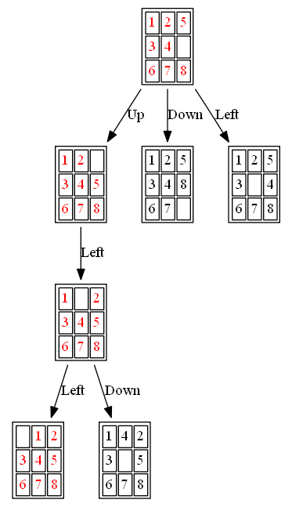
Breadth First Search Algorithm
Implementation
BFS is implemented by using by using Four different movements, these movement function are MoveUp, MoveDown, MoveRight, MoveLeft, there are uses to move the nodes until it finds the correct path.
How it is implemented?
First FindZero function is created to find the zero which in reality is the empty space that allow us to move the number around to find the final state.
After the Zero value is found the movements function are could to move the node, only one node can be move at a time.
This will continue until the final state is found

Slide 8
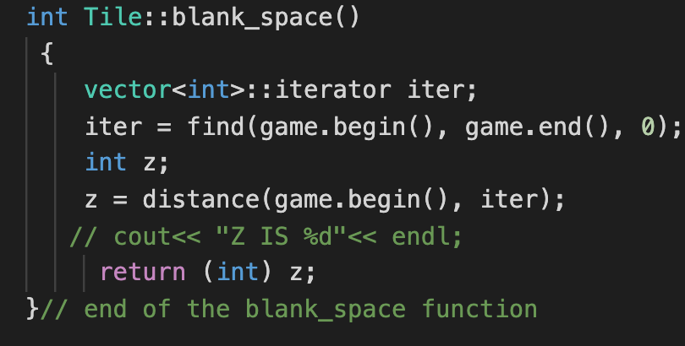
blank_space() Function
This function finds the Zero on the Puzzle,
It help us to know where to start the movements

Slide 9
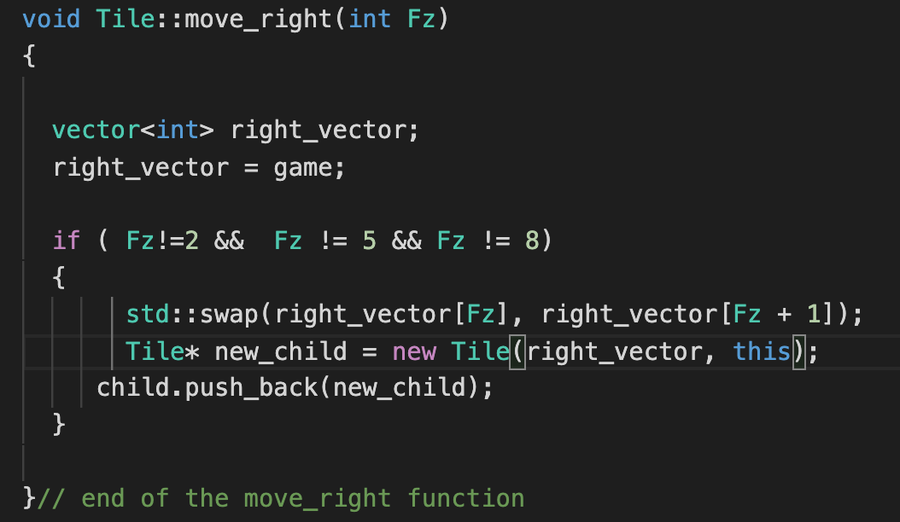
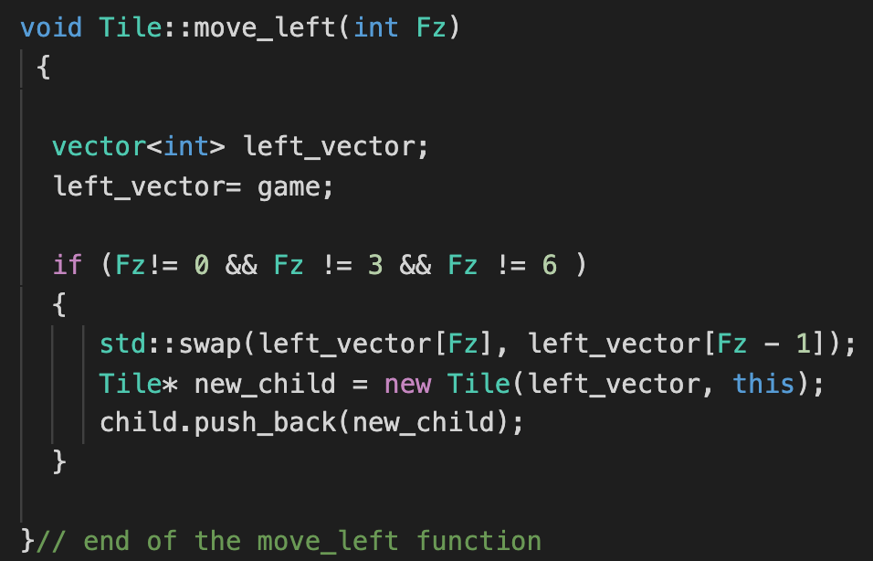
Movement Functions

Slide 10
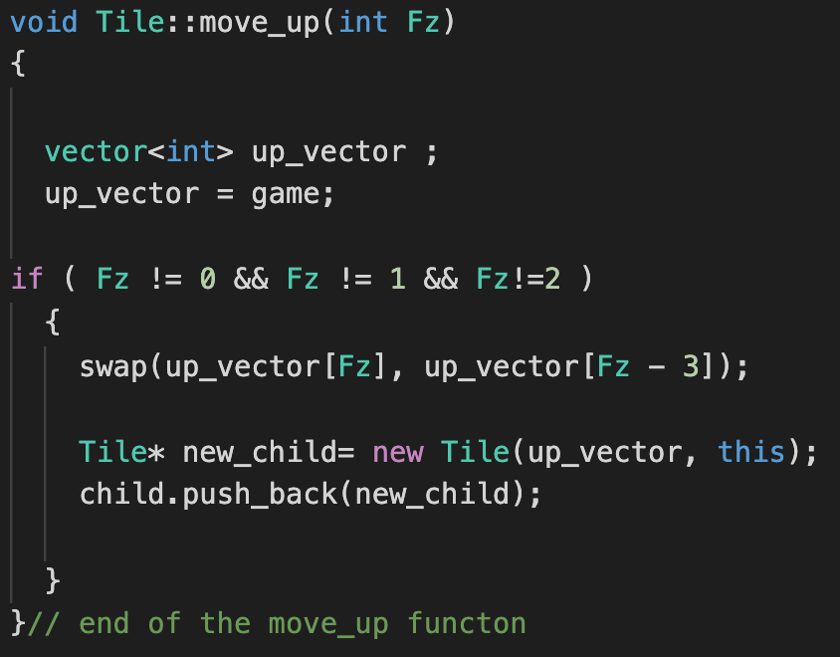
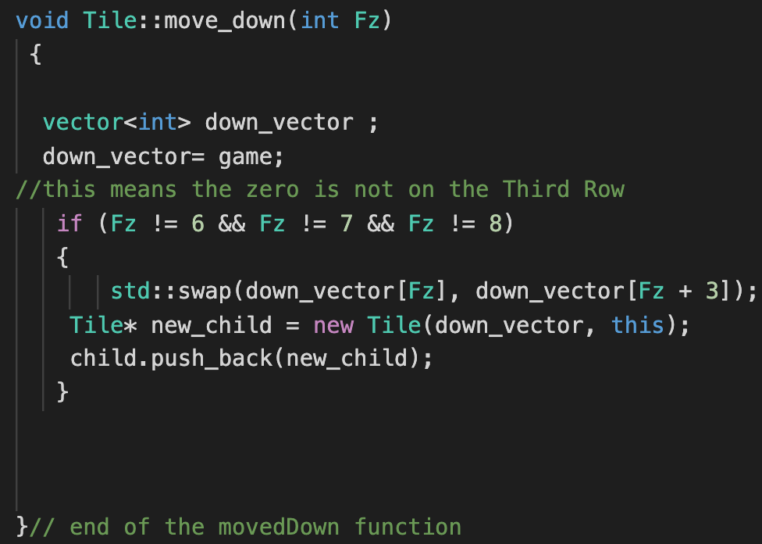
Movement Functions

Slide 11
Depth First Search Algorithm
When analyzing traverse algorithms, DFS is a good option in cases where a graph need to be traversed down a single path, in comparison to BFS which traverse the graph one children at the time. Moreover, having that into consideration, BFS is better for applications where we have to find the shortest path, meanwhile, DFS is more beneficial when to determine if a path to the solution exist. DFS takes O(V+E) as the runtime were V is the number of vertices and E is the number of Edges.

Slide 12
Depth First Search Algorithm
Implementation
The implementation to find the cheapest solution that is approached by DFS is that considering is has a runtime O(V+E) and that the puzzle has a solution. Consist of treating the visited cells of the puzzles as nodes, keeping track of the visited nodes with a boolean. In addition, and stack is useful to keep track of the path being followed. The most efficient way is to use DFS as a recursive function, however, DFS is not the best algorithm to solve the 8-puzzle problem because of the fact that is approach is best for ensuring that there is an actual solution to the problem rather than finding the shortest path.

Slide 13
Dijkstra’s Algorithm
Dijkstra’s algorithm is used for searching and finding the shortest path between nodes in a graph.
Initial State
Goal State
This algorithm begins to read and analyze the puzzle from an initial randomized state
We will use Dijkstra’s algorithm to find the shortest path and cheapest solution to solving a simple 8-puzzle
We calculated the number of displaced tiles for each state of the puzzle and implemented the algorithm to find the cheapest solution to the puzzle
The algorithm prints out the cost of the shortest path and the cheapest sequence of moves that will result in the goal state

Slide 14
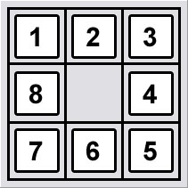
Dijkstra’s Algorithm
Implementation
This program begins by reading in an initial or start state from a file and stores it into a 2D array. The initial state is randomized on each run and is solved using Dijkstra’s algorithm in order to produce a solved puzzle.

Slide 15
Conclusion
We assumed that the puzzle always had a solution.
BFS shows enough evidence to determine that is better for finding the cheapest solution when comparing to DFS which is a best when it come to ensuring that there exist a path or solution to the traverse problem.
We conclude that BFS better in finding solution with fewest movement than DFS and Dijkstra’s algorithm is more faster and optimal algorithm very similar to BFS.

